Slide 1
Cleaning Week 4

Slide 2
In pairs
1.10.1976
5/4/2020
1678-30-01
04-07-2023
Dec, 1, 1849
What are we looking at? Why does it matter?
Address the problem together. Document in DETAIL each step to doing so.
Notes:
Actual job interview question!

Slide 3
What is cleaning?
What is cleaning in their own lives?
What are different ways to clean?
What were take aways from the podcast episode?
Why do it?

Slide 4
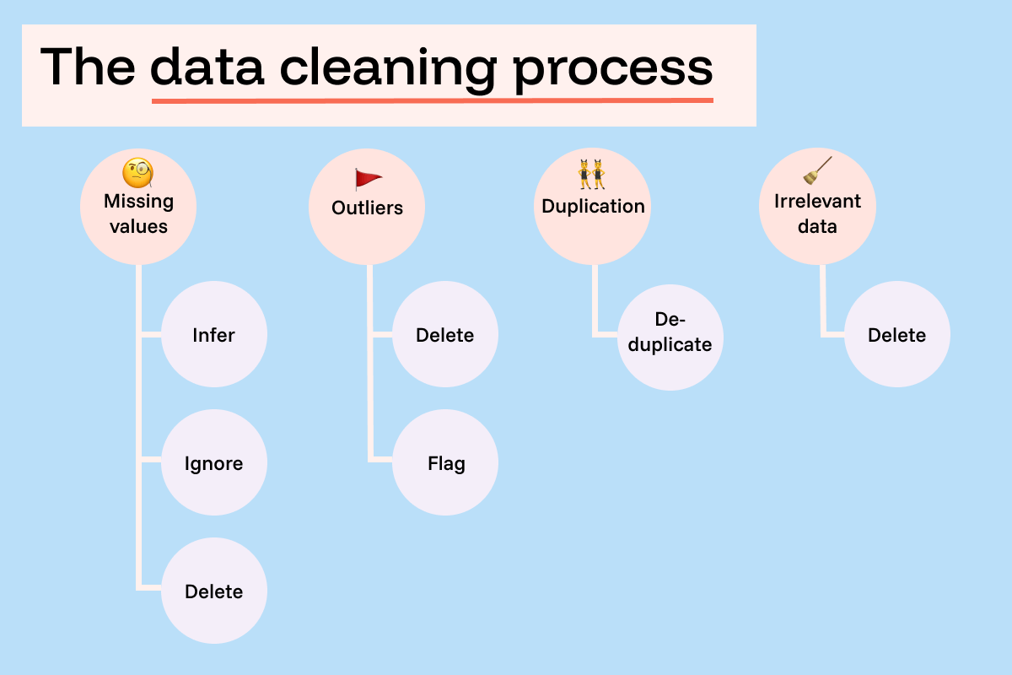
Notes:
https://funnel.io/blog/what-is-data-cleaning-your-complete-guide

Slide 5
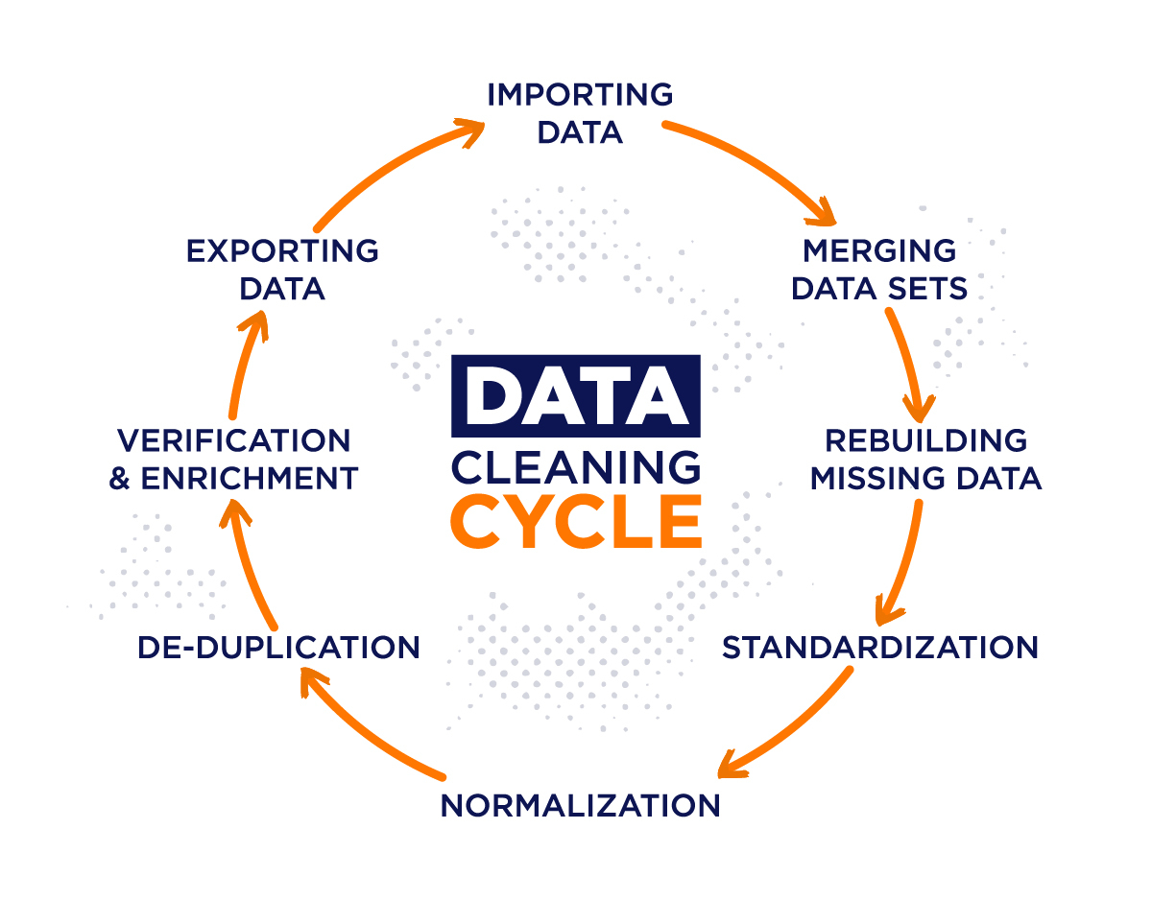
Notes:
From https://airbyte.com/data-engineering-resources/data-cleansing

Slide 6
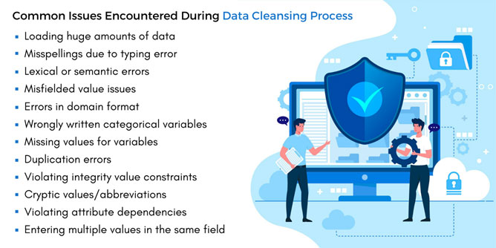
Notes:
https://www.markovml.com/blog/automated-data-cleaning

Slide 7
5 characteristics of quality data
Validity. The degree to which your data conforms to defined business rules or constraints.
Accuracy. Ensure your data is close to the true values.
Completeness. The degree to which all required data is known.
Consistency. Ensure your data is consistent within the same dataset and/or across multiple data sets.
Uniformity. The degree to which the data is specified using the same unit of measure.
Notes:
https://www.tableau.com/learn/articles/what-is-data-cleaning

Slide 8
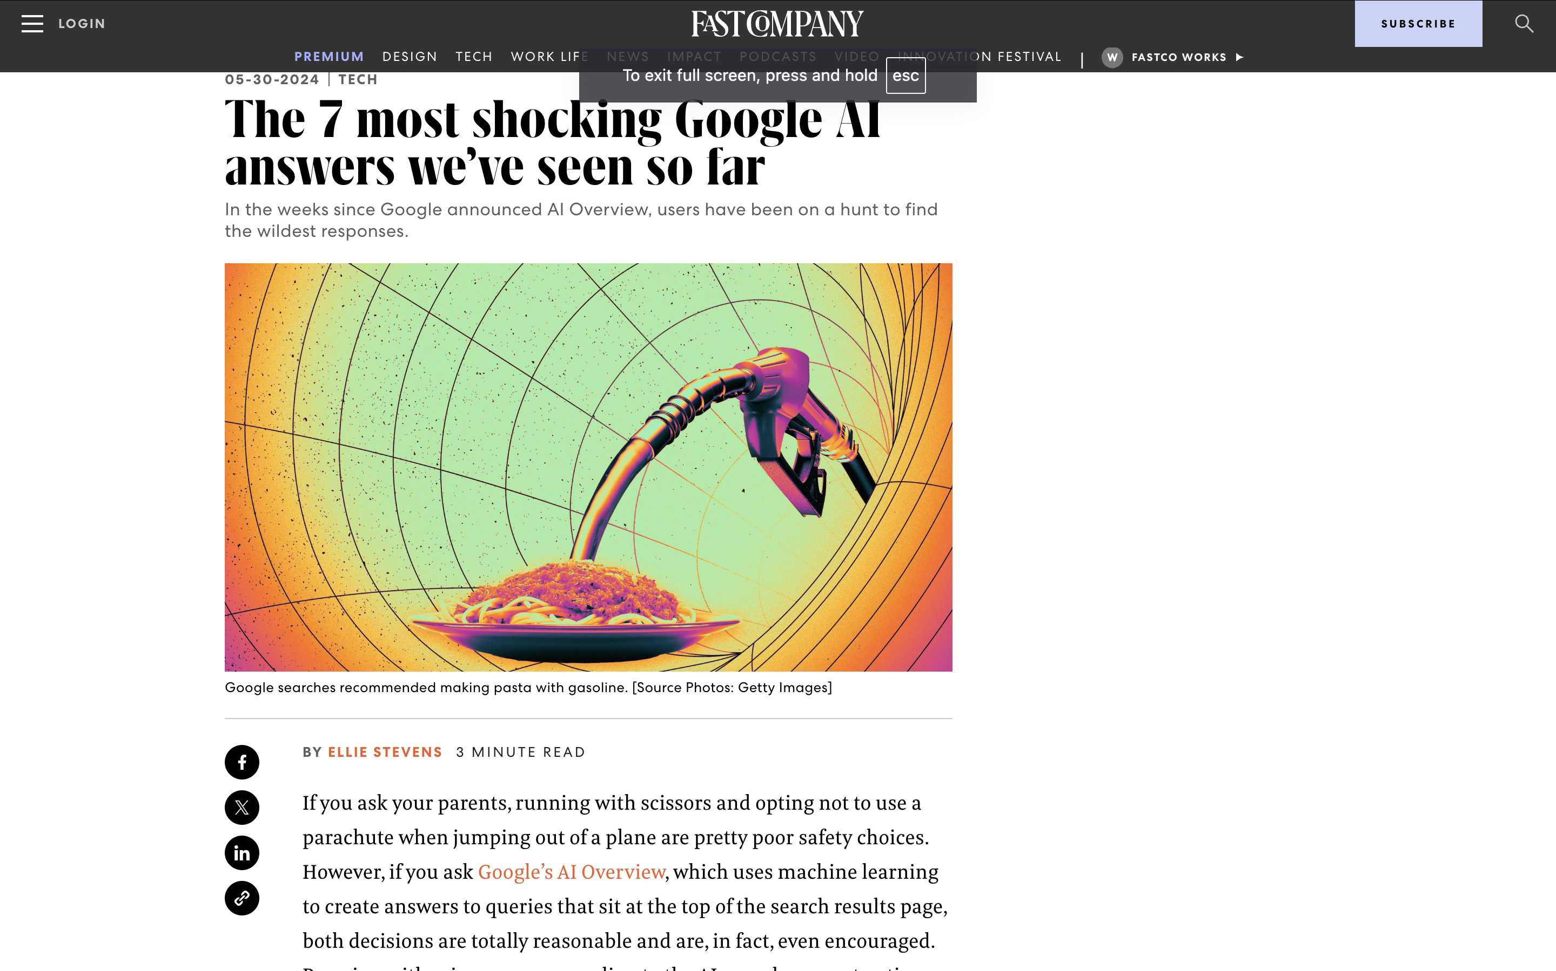
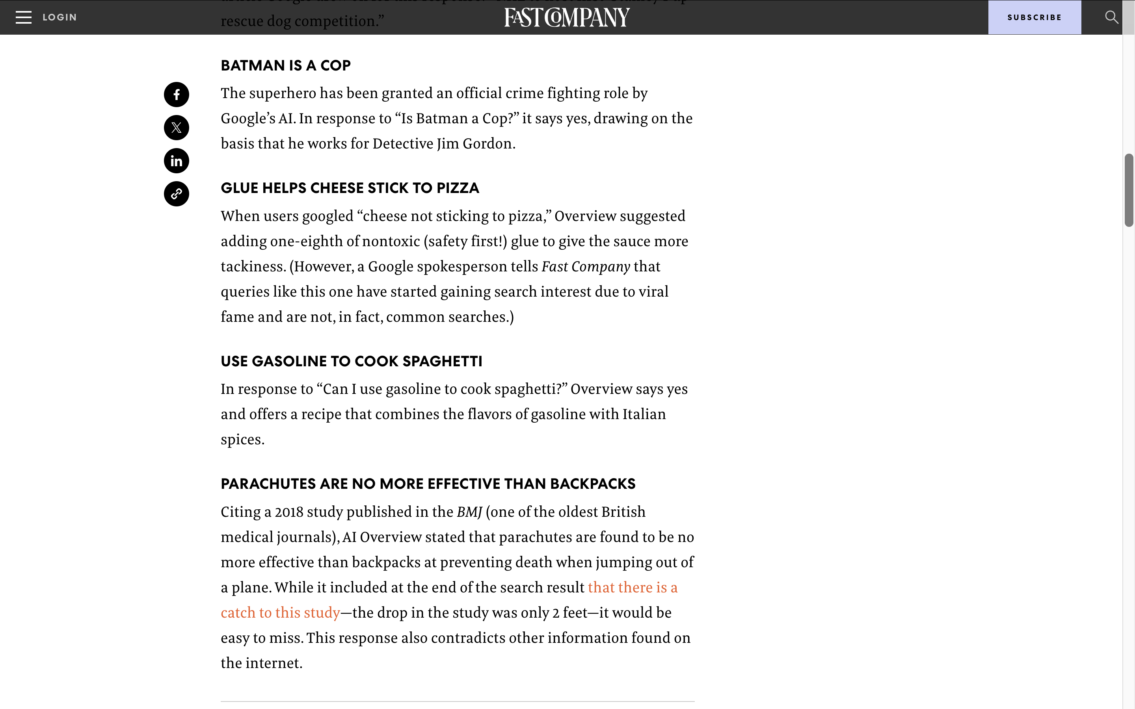
Why Clean
Ensures your analysis is correct
In some cases, actually lets you do it in the first place!
Stay off the front page of the news

Slide 9
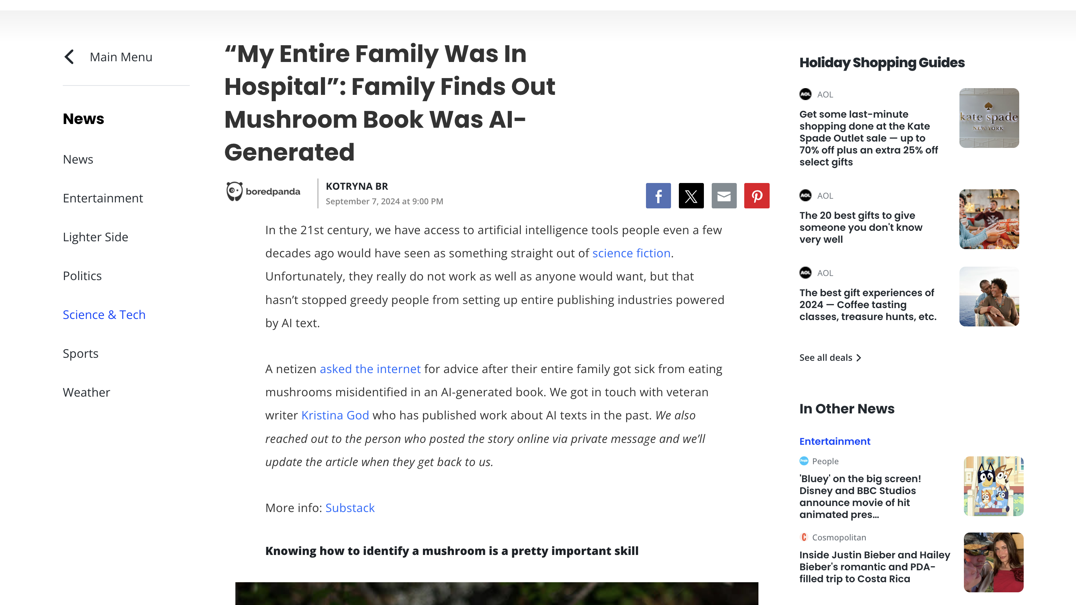
Notes:
Also saves lives

Slide 10
Why Not Clean?
Eliminating difference
Exerting authority over the data (what if they are people?)
“Messy” and “Clean” imply an order that might not exist in life
Perfect might be the enemy of the good

Slide 11
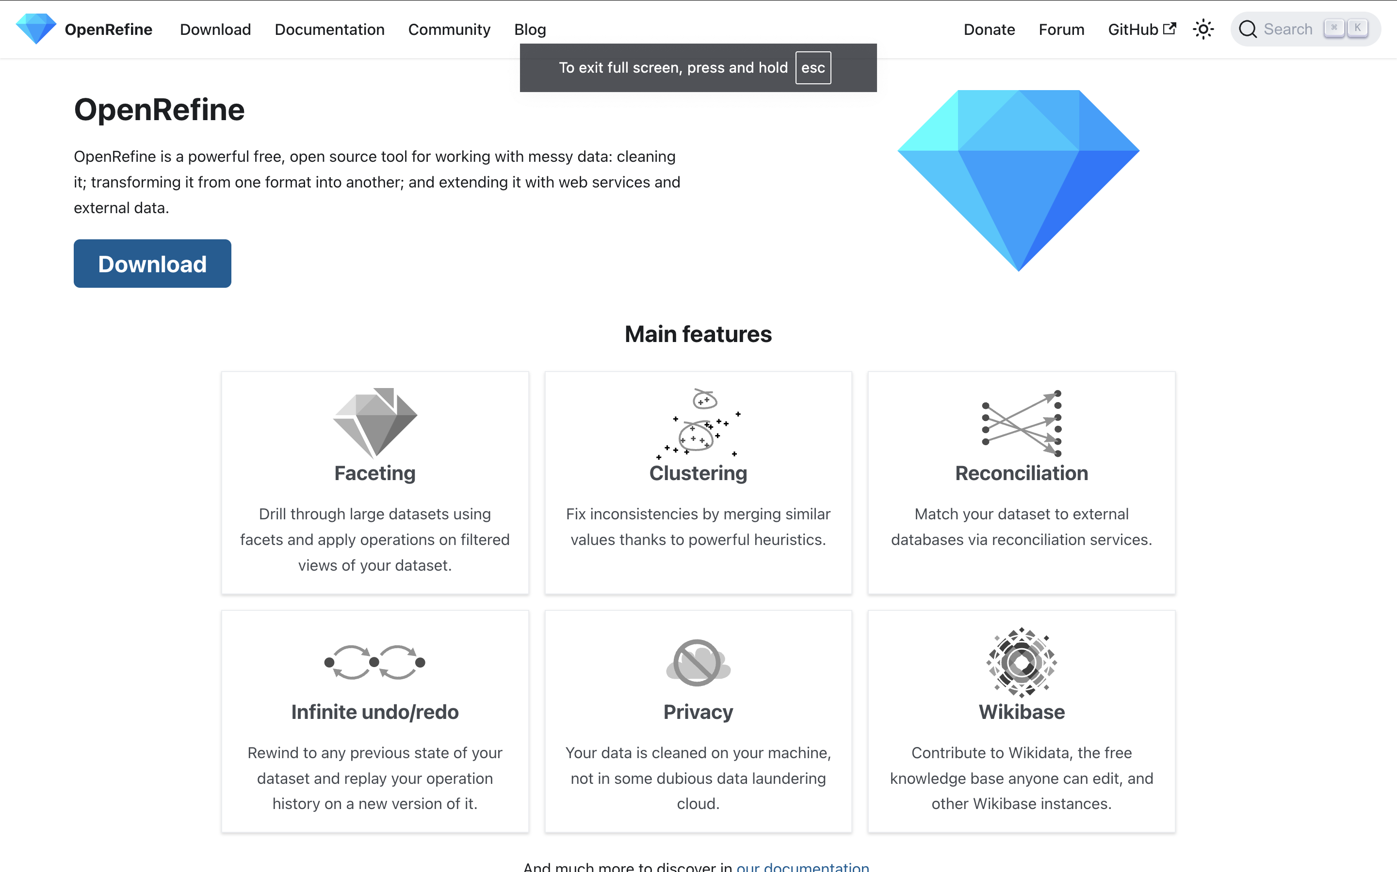
Open Refine Workshop

Slide 12
Setup
Visit https://bit.ly/D4US-audible and download both the uncleaned version and the cleaned one.
Download and install OpenRefine
Compare the uncleaned version and the cleaned one. Then use Open Refine to get from one to the other.
ID what tasks I want them to do in it

Slide 13
Open Refine Workshop

